Slide 1


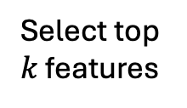
T₁
F₁
Tst₁
Data
Max AUC/Accuracy
T₂
F₂
Tst₂
T₃
F₃
Tst₃
Train folds
Select top $k$ features
Reduce dimension
Train ML
pipeline
Test each fold

